Slide 1
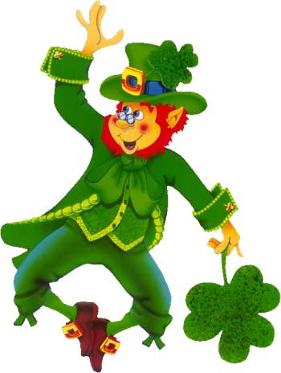
IRISH TROT 5K
FUN RUN/WALK
St. Patrick’s Celebration
P.O. Box 64
Ireland, IN 47545-0064
http://stpat.irelandindiana.com
MARCH 15, 2014
8:00 A.M.
AT
IRELAND ELEMENTARY SCHOOL

Slide 2
REGISTRATION FORM
(PLEASE FILL OUT AND MAIL WITH PAYMENT TO THE ADDRESS ON THE ADJACENT PAGE)
NAME_____________________________________
ADDRESS___________________________________
CITY_____________________STATE____ZIP_______
PHONE NUMBER_____________________________
T-Shirt Size: S M L XL 2XL 3XL
WAIVER AND RELEASE
I hereby for myself, and/or my minor child (if applicable), and the administrators, heirs, and assigns thereof waive and release any and all rights and claims for damages and personal injuries, resulting from negligence, which I or my child may have against; St. Patrick’s Celebration, its officers, directors, employees, and volunteers; the organizers of the St. Patrick’s Celebration Irish Trot 5K Run/Walk; their sponsors, associates, contractors, other entrants and representatives; Dubois county, its boards, elected and appointed officials, and its employees, all for property damage or personal injury, including death that may arise or grow out of my or my minor child’s participation in the St. Patrick’s Celebration Irish Trot. I certify that I and/or my child have prepared for this event. I agree to follow the rules of this race, obey all traffic laws, avoid littering, and respect the property of others.
__________________________________ __________________
SIGNATURE OF PARTICIPANT DATE
_____________________________________________________
SIGNATURE OF PARENT/GUARDIAN IF PARTICIPANT IS UNDER 18
IRISH TROT
5K FUN RUN/WALK
ENTRY FEES
- $15 for entries received by Friday March 7, 2014
(Fee includes T-Shirt.)
$15 for entries received after Friday, March 7,2014
(T-Shirt may not be available.)
PRIZES
$50 prize will be awarded to the top male and female finishers
CHECKS FOR THE ENTRY FEE CAN BE MADE PAYABLE TO THE FOLLOWING:
St. Patrick’s Celebration
ENTRIES FOR THE RUN/WALK MAY BE MAILED TO:
Scott Meyer
4386 W 300 N
Jasper, IN 47546
If you have any questions, please call
634-2512 or 661-2483
ALL PROCEEDS FROM THE EVENT ARE DONATED TO IRELAND COMMUNITY PROJECTS

